Slide 1
The Treasure of Lemon Brown
By Walter Dean Myers
p. 170-178

Slide 2
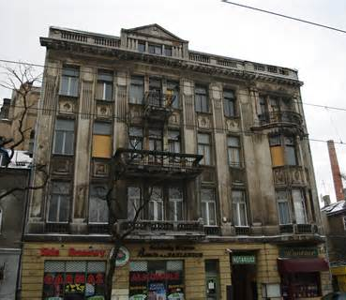
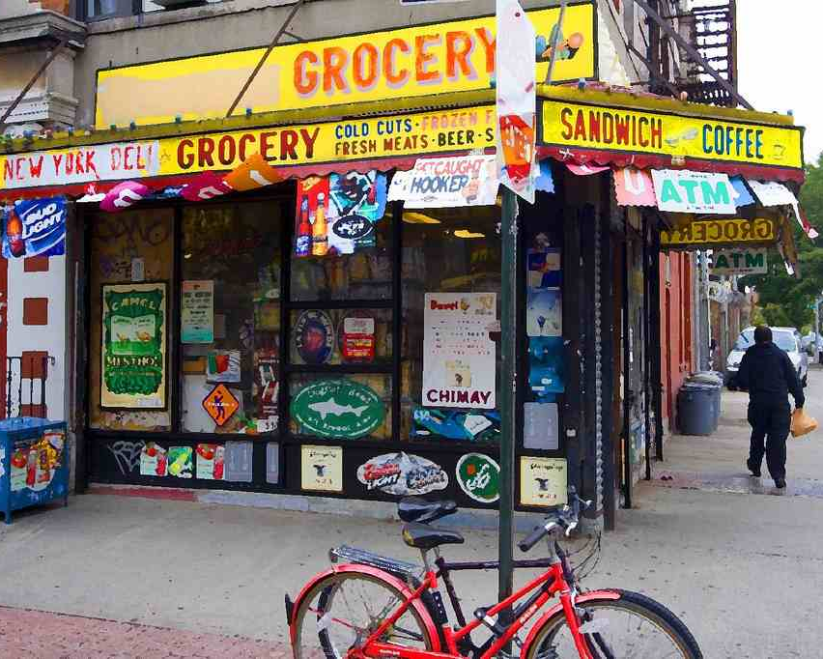
Down the block there was an old tenement that had been abandoned for some months.
From this spot he could see the blinking neon sign over the bodega on the corner. He sat a while, watching the sign blink first green then red, allowing his mind to drift to the Scorpions, then to his father.

Slide 3
What is the point of view of this story? How do you know?
The dark sky, filled with angry, swirling clouds, reflected Greg Ridley’s mood as he sat on the stoop of his building. His father’s voice came to him again, first reading the letter the principal had sent to the house, then lecturing endlessly about his poor efforts in math.
“I had to leave school when I was 13,” his father had said,” that’s a year younger than you are now. If I’d had half the chances that you had, I’d…”
Greg had sat in the small, pale green kitchen listening, knowing the lecture would end with his father saying he couldn’t play ball with the Scorpions. He had asked his father the week before, and his father had said it depended on his next report card. It wasn’t often the Scorpions took on new players, especially 14-year-olds, and this was a chance of a lifetime for Greg. He hadn’t been allowed to play high school ball, which he had really wanted to do, but playing for the Community Center team was the next best thing.
Lines 1-13

Slide 4
“Don’t try nothing’ ‘cause I got a razor here sharp enough to cut a week into nine days!”
Lines 68-69

Slide 5
How does knowing Greg’s thoughts and actions affect your impression of Lemon Brown?
The person who called himself Lemon Brown peered forward, and Greg could see him clearly. He was an old man. His black, heavily wrinkled face was surrounded by a halo of crinkly white hair and whiskers that seemed to separate his head from the layers of dirty coats piled on his smallish frame. His pants were bagged to the knee, where they were met with rags that went down to the old shoes. The rags were held on with strings, and there was a rope around his middle. Greg relaxed. He had seen the man before, picking through the trash on the corner and pulling clothes out of a Salvation Army box. There was no sign of the razor that could “cut a week into nine days.”
Lines 85-93

Slide 6
How would this passage be different if you knew what Lemon Brown was thinking?
As Greg howled, the light moved away from Lemon Brown, but not before Greg saw him hurl his body down the stairs at the men who had come to take his treasure. There was a crashing noise, and then footsteps. A rush of warm air came in as the downstairs door opened, then there was only an ominous silence.
Lines 196-200

Slide 7
Why does the thought of his father’s lecture make Greg smile?
Greg pushed the button over the bell marked Ridley, thought of the lecture he knew his father would give him, and smiled.
Lines 292-293

Slide 8
What is the theme (lesson / moral) of The Treasure of Lemon Brown?
Everyone has a treasure, something to protect, and it’s not always expensive.
How do you know this is the theme?
Lemon Brown’s harmonica and newspaper clippings are his most prized possessions because they told his son who he was. They are also important because they help him remember his son.

Slide 9
Homework Assignment
In the second tab of your notebook: Answer questions 1-5 on p. 179 (see Mrs. Newhouse’s website)
Think about something that you treasure. It doesn’t need to have monetary value, but should be something you consider precious.

Slide 10
1. How does Greg meet Lemon Brown?
2. How does Lemon Brown scare off the intruders?
3. Why does Lemon Brown cherish his treasure?
4. Whose sights, thoughts, and feelings does the narrator present? Explain how the story might be different if readers knew more about the thoughts of the other characters.
5. How do Greg’s feelings toward Lemon Brown change over time? In a graphic like the one shown, note important events from the story. Under each event, tell how Greg feels about Lemon Brown at that point.
Greg hears Greg sees
Lemon Brown Lemon Brown
scared relieved

